Slide 1



Introduction to data management planning
Joy Davidson
Digital Curation Centre
Funded by:

Slide 2
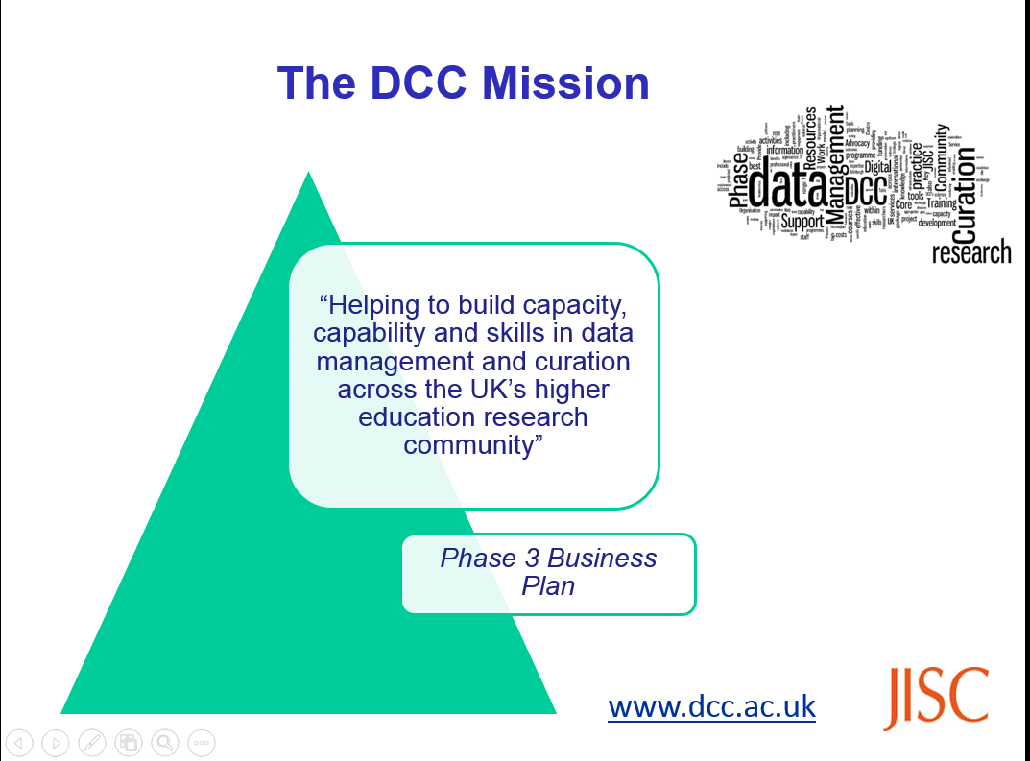
Digital Curation Centre (DCC)
Notes:
Currently funded by Jisc and European Commission activity, the DCC has been around for 12 years. DCC was originally funded jointly by Jisc and EPSRC under the eScience programme (2004-2007). Illustrates that EPSRC has been considering the challenges around longer term curation of research data for some time.
2

Slide 3
What is Research Data Management?
Data Management Planning
Creating data
Documenting data
Accessing / using data
Storage and backup
Selecting what to keep
Sharing data
Data licensing and citation
Preserving data
Create
Document
Use
Share
Preserve
Store
Create
Document
Use
Share
Preserve
Store
Create
Document
Use
Share
Preserve
Store
Notes:
The active management of data throughout the lifecycle

Slide 4
Why manage research data?
Direct benefits for you
To make your research easier!
Stop yourself drowning in irrelevant stuff
Have data organised so you know which versions are most up-to-date
Make sure you can understand and reuse your data again later
Research integrity
To avoid accusations of fraud or bad science
Evidence findings and enable validation
Codes of practice on good research conduct
Many research funders worldwide now require Data Management and Sharing Plans
Potential to share
So others can reuse and build on your data
To gain credit –higher citation rates when data are shared
For greater impact and new collaborations
Promote innovation and allow research in your field to advance faster

Slide 5
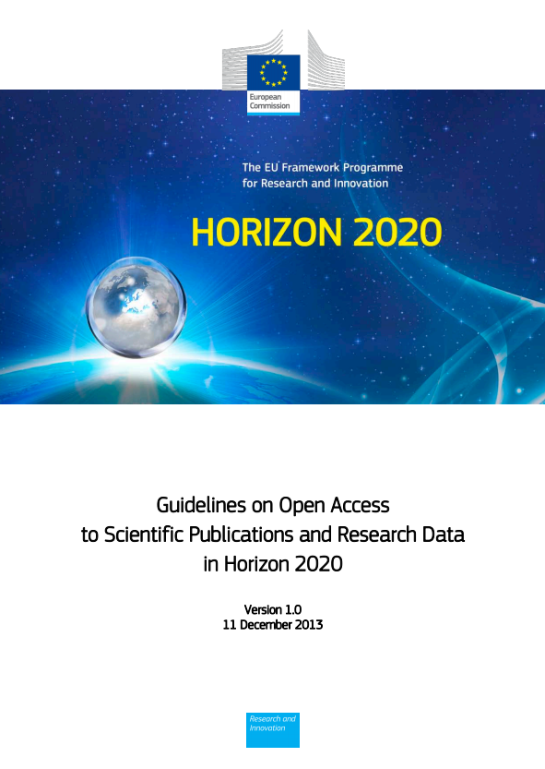
Funders have expectations about data sharing…
“The European Commission’s vision is that information already paid for by the public purse should not be paid for again each time it is accessed or used, and that it should benefit European companies and citizens to the full.”
http://ec.europa.eu/research/participants/data/ ref/h2020/grants_manual/hi/oa_pilot/h2020-hi-oa-pilot-guide_en.pdf
Data management plans requested for those
participating in Open Data pilot.
Notes:
Funding body mandates have been a key driver for improving RDM infrastructure and practice. RCUK issued its common principles on research data several years ago to address this need for transparency and value.
Funders have an obligation to show that public funds are being allocated appropriately. Important to note that funders need to demonstrate impact too. Otherwise research budgets shrink!
Not just UK, H2020 open data pilot and enthusiasm for Open science.
Important to stress that funders are NOT saying that ALL data must be kept or shared. Funders expects responsible research practice.
The background to this is about making the most of the data that has been created through publicly funded research. The guidelines speak of:
Improved quality of results
Greater efficiency
Faster to market = faster growth
Improved transparency of the scientific process
5

Slide 6

…but RDM is part of good research practice!
“Data sets are
becoming the new instruments of
science”
Dan Atkins, University of Michigan
Notes:
Data driven research is becoming the norm for all disciplines even arts and humanities. To be effective in this era, researchers need access to high quality data.
Currently, there are very worrying stats around the percentage of published findings that are reproducible.
6

Slide 7
Data management
plans (DMPs)
Notes:
For the next few slides, I’ll consider some of the ideals we’d like to see in data management planning.

Slide 8
What should be addressed in a DMP?
What data will be created (format, types, volume...)
Standards and methodologies to be used (incl. metadata)
How ethics and Intellectual Property will be addressed
Plans for data sharing and access
Strategy for long-term preservation
Create
Preserve
Document
A DMP is a plan to share!
Share
Use
Store
Notes:
First of all, what is a Data Management Plan (dmp)?
Essentially, most funders just want evidence at the grant stage that data has been considered – how much will be generated? Usually just a 1-2 page summary covering the expected data to be produced through research along with an idea of what might be shared and how and when it will be shared.
It is important to stress that funders aren’t expecting something carved in stone at this stage. Projects often change quite radically from what is submitted at the proposal stage and this is ok. Researchers just need to be able to provide evidence that they have thought about the data they might be generating and how it will be managed and shared.
In terms of preservation, it is important to remember that not ALL data has to be retained. Selecting what data needs to be kept is something that only the researcher can do. Essentially, he/she will need to retain any data that underpins published findings to allow for validation of results. Additional data that is not required for validation purposes but is deemed to have longer-term value might also be worth keeping.
DMPs are often submitted as part of grant applications, but are useful whenever you’re creating data. Some HEIs are introducing policies that require DMPs for all research undertaken by staff – whether externally funded or not.

Slide 9
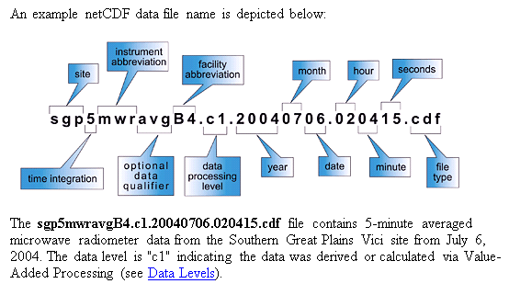
How will you name your files?
Keep it simple!
Agree methods with partners
Include dates
Avoid non-alphanumeric characters
Use hyphens or underscores not spaces e.g. day-sheet, day_sheet
Order the elements logically
Example from ARM Climate Research Facility www.arm.gov/data/docs/plan
www.jiscdigitalmedia.ac.uk/guide/choosing-a-file-name
Notes:
Keep file and folder names short, but meaningful
Agree a method for versioning
Include dates in a set format e.g. YYYYMMDD
Avoid using non-alphanumeric characters in file names
Use hyphens or underscores not spaces e.g. day-sheet, day_sheet
Order the elements in the most appropriate way to retrieve the record

Slide 10
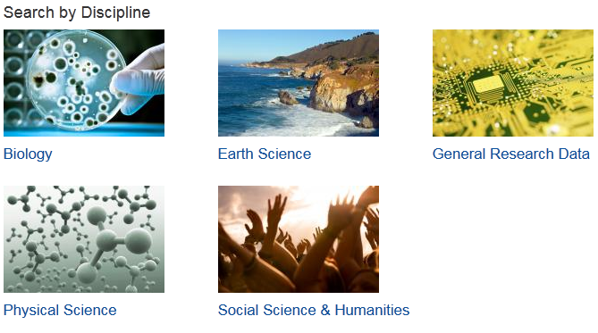

How should you describe your data?
http://www.dcc.ac.uk/resources/metadata-standards
Notes:
Use an existing standard whenever possible (almost always!) DCC Metadata catalogue, explaining what they are, who's using them and how to use them. Ideally, use of standard unique IDs (grant, ORCIDs, funders, institution, DOIs). Metadata should capture provenance info. WC3 PROV-O standard and Australian National Data Services (ANDS) work might be relevant. Think about what is needed in order to find, evaluate, understand, and reuse the data.
Have you documented what you did and how?
Did you develop code to run analyses? If so, this should be kept and shared too.
Is it clear what each bit of your dataset means? Make sure the units are labelled and abbreviations explained.
Record metadata so others can find your work e.g. title, date, creator(s), subject, format, rights…,
10

Slide 11
Where will you store the data during your research?
Your own laptop
University systems
Cloud storage
Combination
Your decision will be based on how sensitive your data are, how robust you need the storage to be, who needs access to the data, and when they need access to the data!
Notes:
Your own device (laptop, flash drive, server etc.). And if you lose it? Or it breaks?
Departmental drives or university servers
“Cloud” storage. Do they care as much about your data as you do? Read the fine print!
Most likely a mixture so be clear on which data will be stored in which place.
Remember to consider backup!
Use managed services where possible (e.g. University filestores rather than local or external hard drives), so backup is done automatically
Good practise is to have at least 3 copies of a file on at least 2 different media with at least 1 offsite
Ask central IT team for advice

Slide 12
Which data need to be kept after the project ends?
Five steps to follow
Could this data be re-used
Must it be kept as evidence or for legal reasons
Should it be kept for its potential value
Consider costs – do benefits outweigh cost?
Evaluate criteria to decide what to keep
5 steps to decide what data to keep
www.dcc.ac.uk/resources/how-guides/five-steps-decide-what-data-keep
Notes:
Most funders expect enough data to be kept to enable validation of published findings at a minimum. But other data may also have value.
Not always the data – sometimes the code or algorithm more valuable and data can be easily recaptured.

Slide 13
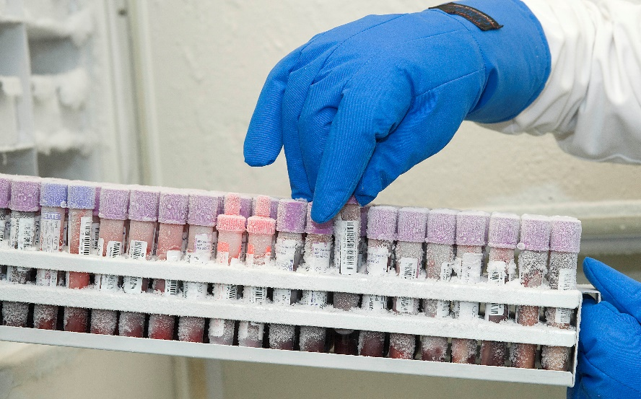
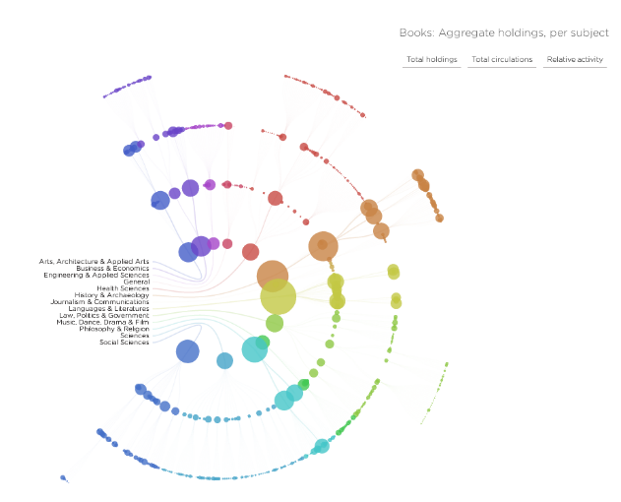
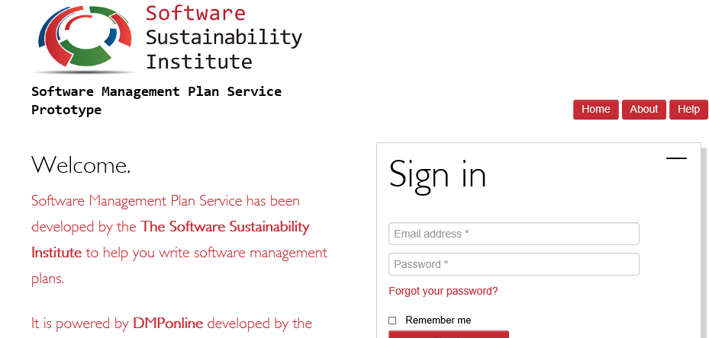
Remember to consider physical data, software and models
http://www.ukcrcexpmed.org.uk/Coventry_Warwick_CRF/PublishingImages/Tissue%20Bank%201.jpg
http://spatialinformationdesignlab.org/project_sites/library/catalog.html
https://ssi-dev.epcc.ed.ac.uk/
Notes:
Remember that not all research data is digital. Consider how you will maintain links between research outputs and analogue data like tissue samples. How will access to these resources be provided if needed?
In some cases, algorithms and models are more valuable than the data being run through them so be clear on what it is you need to keep (e.g., genomic data and models).

Slide 14
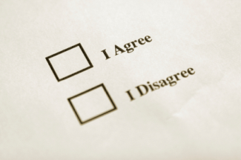
Can your data be shared with others?
PI/researcher
Data repository and support staff
Research participants
Commercial partners
Secondary data user
Notes:
While the researchers themselves will have a key role to play in sharing data, it is important to note that they are not the only stakeholders involved in the process.
Repository – how will data be made visible? Especially if physical data?
Support staff – e.g., Library staff to help describe data to make it easier to find and understand.
Research participants – informed consent is required. Anonymisation can be very costly.
Commercial – identify what can and can’t be shared and make this explicit. Develop consortium agreements that make each partners rights explicit.
Secondary user – when sharing data, researchers can ask reusers to tick that they accept terms and conditions regarding fair use
14

Slide 15
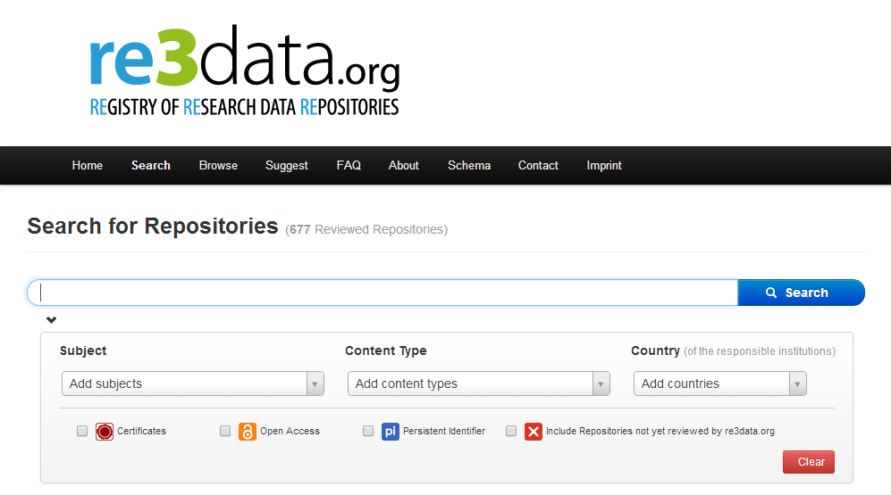
How will it be shared?
Does your publisher or funder suggest a repository?
Are there data centres or community databases for your discipline?
Does your university offer support for long-term preservation?
Zenodo
Joint effort by OpenAIRE-CERN
Multidisciplinary repository
Multiple data types
Citable data (DOI)
Links funding, publications, data & software
www.zenodo.org
http://service.re3data.org/search
Notes:
Ideally, we’d like to see researchers embrace Open Science and make as much of their data available with as few restrictions as possible. However, where that isn’t possible, it is important to be clear on why data can’t be shared.
Provide a recommended data citation for data set. UK Data Service provides information on tools that are helpful for citing specific sections of interviews and other types of social science data that might be collected.
15

Slide 16
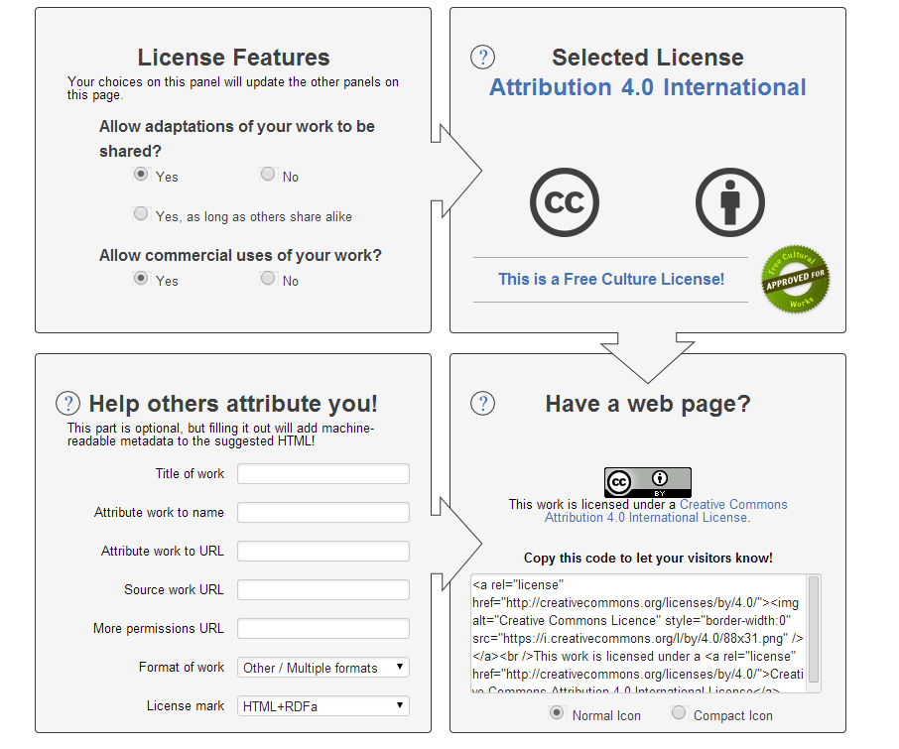
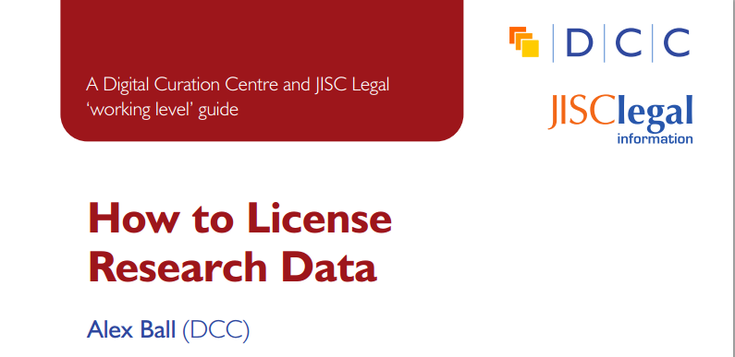
What do you want others to be able to do - or not do - with your data?
www.dcc.ac.uk/resources/how-guides/license-research-data
http://creativecommons.org/choose/
Notes:
For data that can be published, ensure potential reusers are clear about what can and can‘t be done with data by applying a relevant license.
Researchers should be able to exploit commercial potential by selecting the right license (e.g., not closing any doors).
Researchers should be aware of any restrictions on using third party data in their research and be clear on what they can share while respecting licenses on others' data.

Slide 17
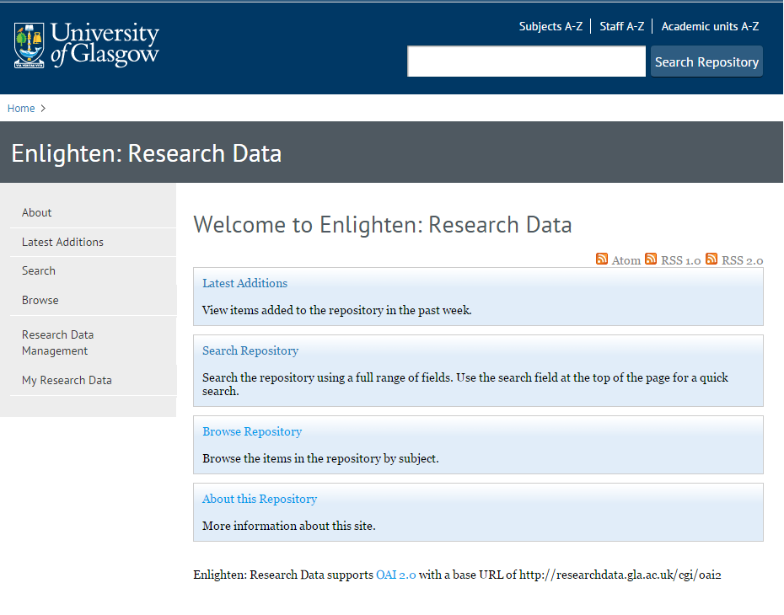
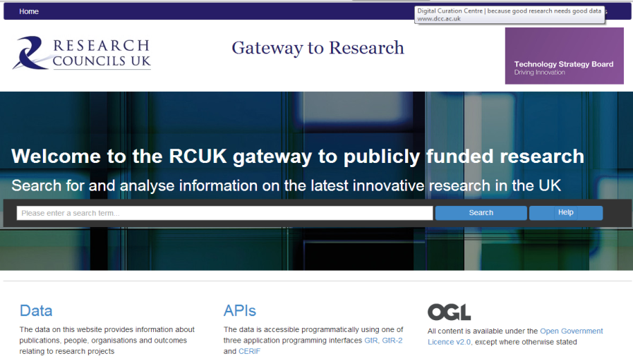
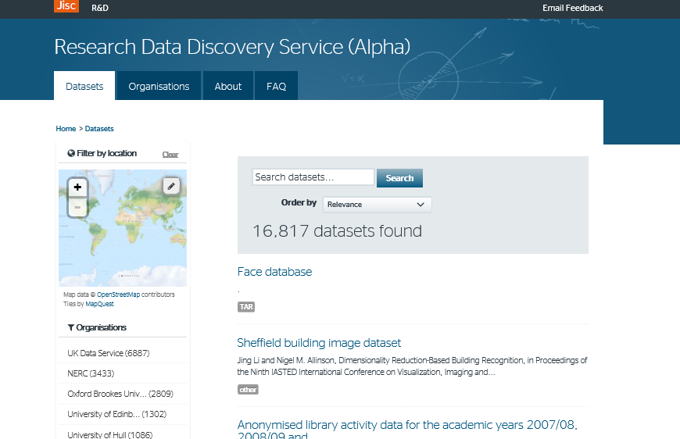
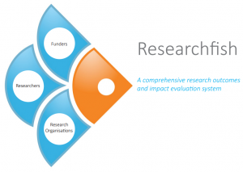
How will you make your data discoverable?
http://gtr.rcuk.ac.uk/
http://researchdata.gla.ac.uk/
https://www.researchfish.com/
http://ckan.data.alpha.jisc.ac.uk/dataset
Notes:
Depositing into a repository is good. But how can you make sure that your data can be most easily found and reused?
A myriad of discovery mechanisms. Institutional data catalogues, national discovery services and funder registries. It would be ideal if data was entered once and shared between these systems more effectively.
17

Slide 18
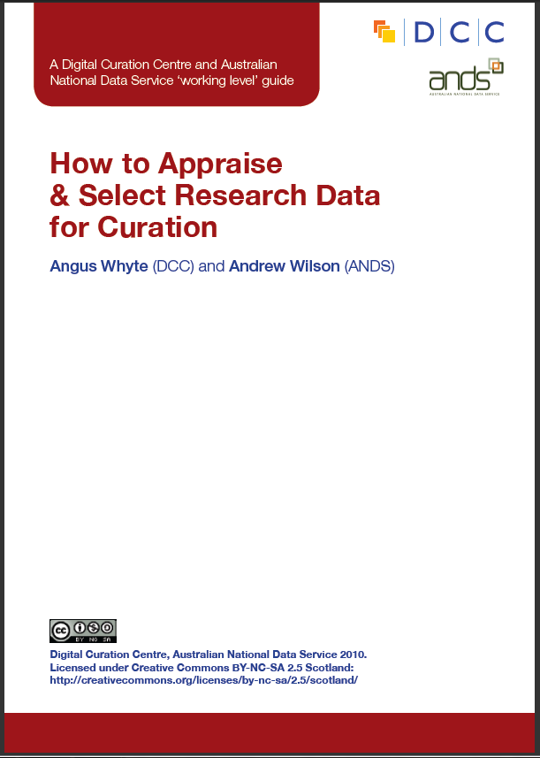
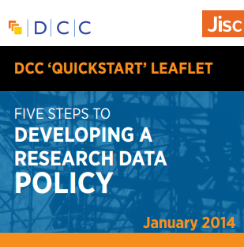
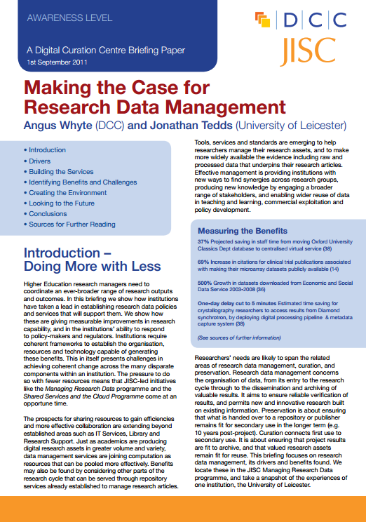
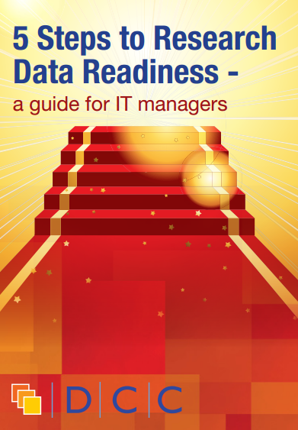
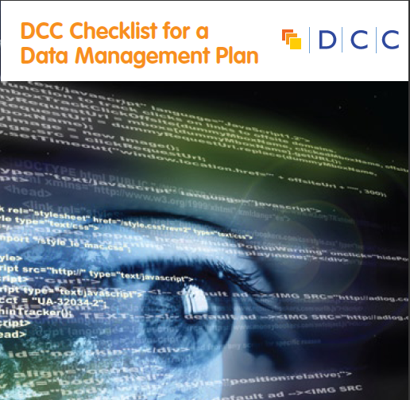
Refer to free guides and briefing papers
www.dcc.ac.uk/resources/
Notes:
DCC provides free access to a number of short, practical guides on various topics:
-How to discover RDM requirements
-How to develop RDM services
-How to develop a data management and sharing plan
-How to appraise and select research data
-How to write a lay summary
-How to licence research data
-How to cite datasets and link to publications

Slide 19

Make use of free tools
https://dmponline.dcc.ac.uk
Notes:
Web-based tool to help researchers write Data Management and Sharing Plans according to different funder / institutional requirements
There are various templates in DMP Online based on different funder requirements and institutional customisations.
We’re currently enhancing it with practical examples, boilerplate text and tailored support. TEDDINET may wish to develop discipline specific guidance within the tool for future related projects.
19

Slide 20
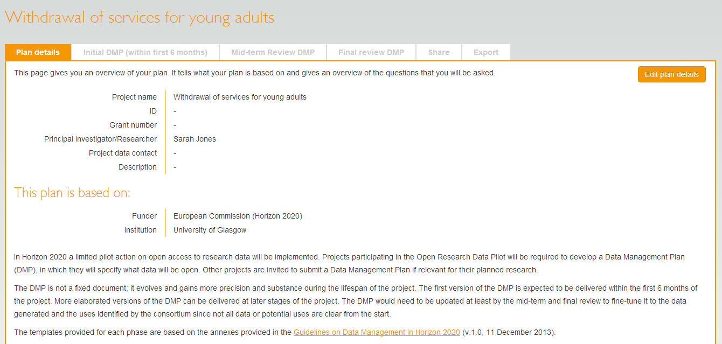
Update your plan!
Phases
… most do not update the DMP throughout the
life of the project.
Notes:
Consider reviewing the plan at lease as often as you provide updates to your funder. Consider making your final phase DMP public via your institutional repository and link it to you publication and data set.
Consider publishing the final version DMP as a data paper – increasing number of peer reviewed data journals emerging. Good to get credit for your efforts!
20

Slide 21
Good practice when creating DMPs
☑ Start early
☑ Cost in sufficient effort to application
☑ Write the plan collaboratively
☑ Be realistic
☑ Update DMP
Notes:
Start early!
Justify additional resource needed for RDM and add to proposed budget
Do not to write the plan in isolation – seek advice from colleagues (ethics, IT, library)
Be realistic - base plans on available skills & support. Don't gold plate plan.
Update the plan - change over time!

Slide 22

Good RDM helps you comply with mandates but also leads to…
More visible research outputs and increased impact - even for negative results
Easier outputs reporting
Better and more reproducible research!

Slide 23
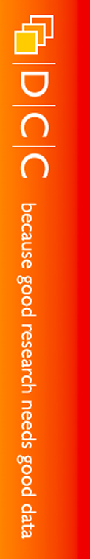
Thanks for listening!
joy.davidson@glasgow.ac.uk
www.dcc.ac.uk
Follow us on twitter:
@jd162a
@digitalcuration and #ukdcc

